Slide 1
Maps
Ian Kerr

Slide 2
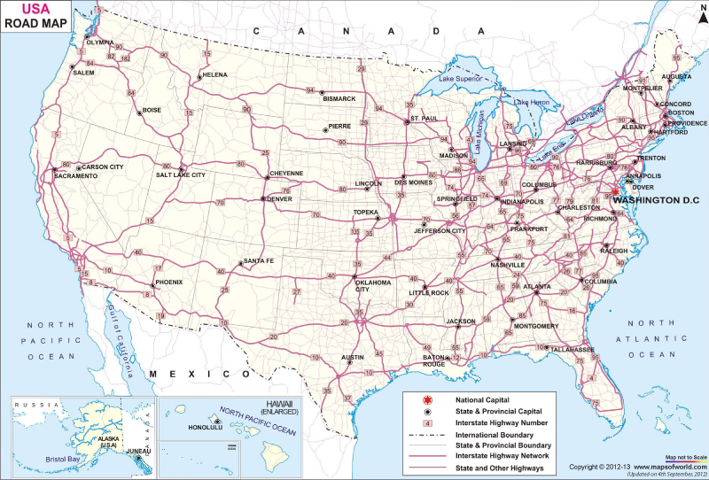
Road map
A road map shows roads borders and destinations

Slide 3
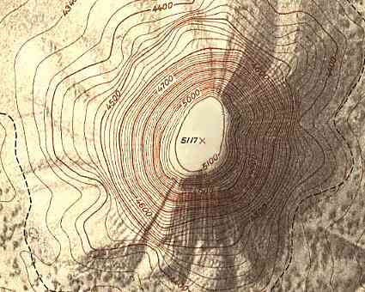
Topographic Map
A topographic map uses lines to show contours in the earth and height of objects

Slide 4
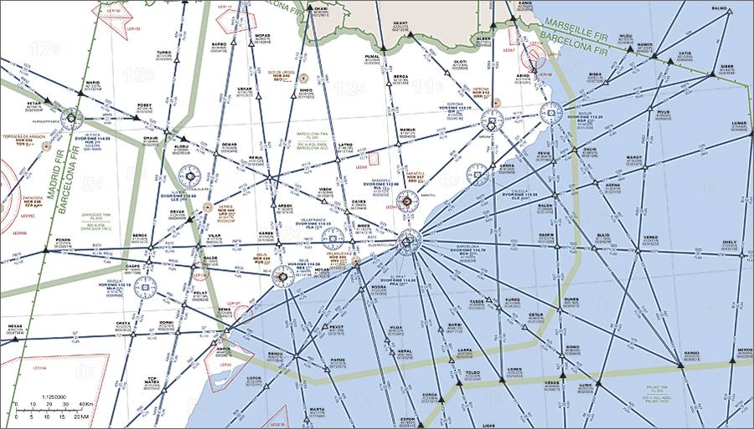
Aeronautical Map
An aeronautical map shows the flight path of planes

Slide 5
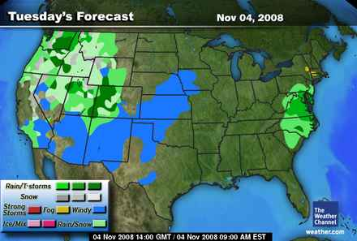
Weather Map
A weather map shows temperature, cloud cover and rain in real time

Slide 6
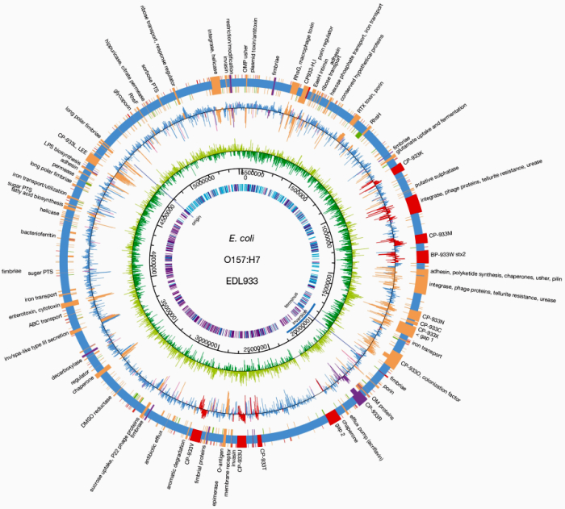
Gene Map
A gene map is a visual representation of the structure of gene

Slide 7
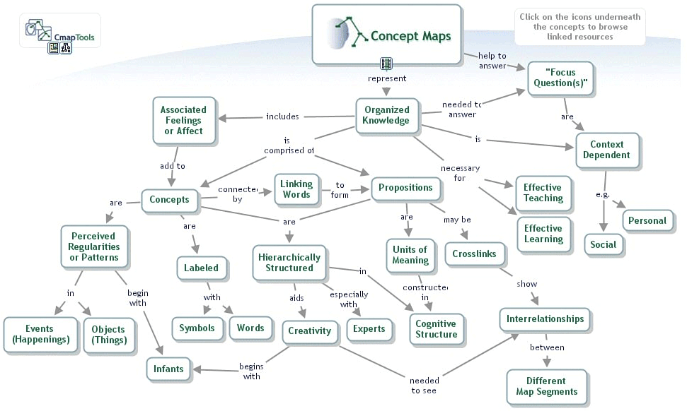
Concept Map
A concept map is a visual representation of a concept

Slide 8
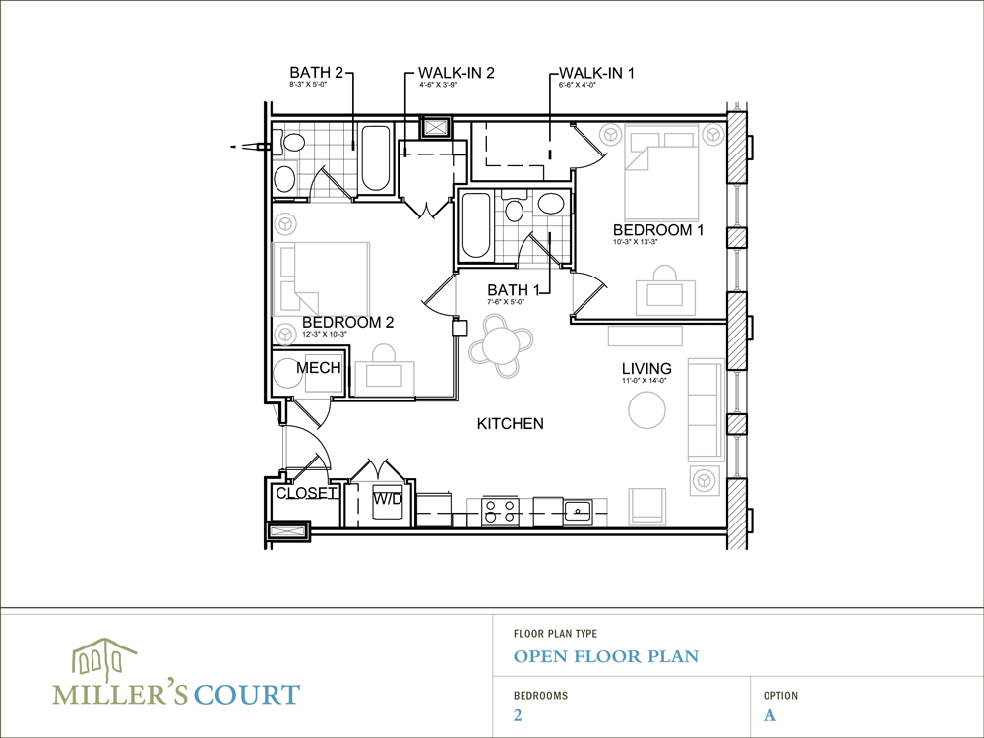
Floor Plan
A floor plan is a birds eye view of all the rooms on a floor

